Slide 1
JDBC API
Java Database Connectivity

Slide 2
JDBC
Load Driver
Establish Connection
Retrieving Values
Updating Tables
Prepared Statements

Slide 3
Database Drivers
A bridge between your Java application and the database
Java Application
MySQL Driver
MS SQL Driver
Oracle Driver
MySQL
MS SQL Server
Oracle

Slide 4
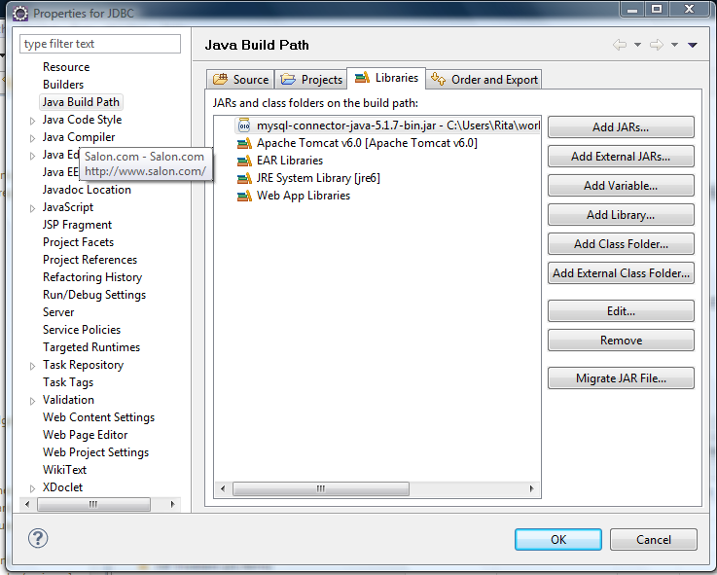
Add the Database Driver to Your Build Path

Slide 5
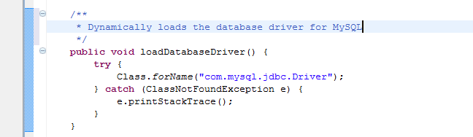
Load the Driver
Loading a class dynamically by its name
http://cephas.net/blog/2005/07/31/java-classfornamestring-classname-and-jdbc/

Slide 6
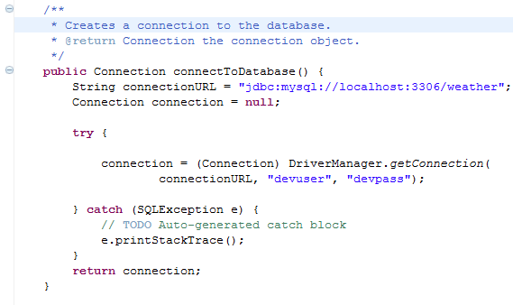
Connect to the Database

Slide 7
Statements
The object used for executing a static SQL statement and returning the results it produces.
By default, only one ResultSet object per Statement object can be open at the same time. Therefore, if the reading of one ResultSet object is interleaved with the reading of another, each must have been generated by different Statement objects.

Slide 8
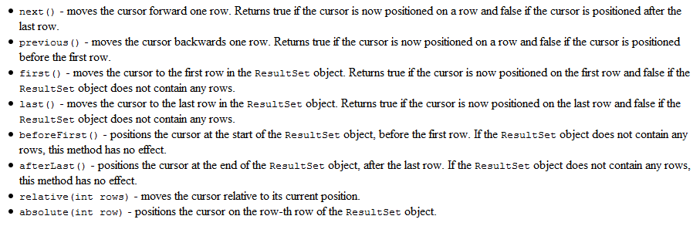
ResultSet
ResultSet is an object containing records from the database
Source: http://java.sun.com/docs/books/tutorial/jdbc/basics/retrieving.html

Slide 9
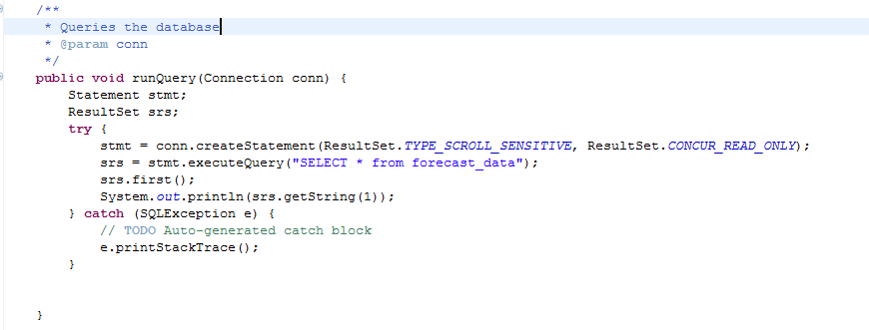
Query the Database

Slide 10
ResultSet Types
TYPE_FORWARD_ONLY (Default)
Can only scroll forward through a result set
TYPE_SCROLL_INSENSITIVE
The result set can be scrolled forward or backward for records. Changes to the database are not reflected in the record set
TYPE_SCROLL_SENSITIVE
The result set can be scrolled forward or backward for records. Changes to the database ARE reflected in the record set

Slide 11
Updatable
CONCUR_READ_ONLY (Default)
The ResultSet may NOT be updated
CONCUR_UPDATABLE
The ResultSet may be updated

Slide 12
Cursor is pointing before the first record before a call to next()
ResultSet
cursor
resultSet.next();
cursor
Record
Record
Record
Record

Slide 13
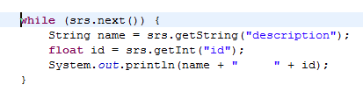
Getting Values from the ResultSet
Iterating forward through a result set

Slide 14
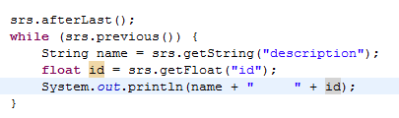
Getting Values from the ResultSet
Iterating backwards through a ResultSet

Slide 15
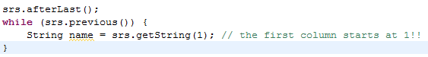
Getting Values From the ResultSet
Can get values from the column index or column name
You can use getString() for all the basic datatypes and then cast if desired.
Notes:
Column Index is usually more efficient

Slide 16
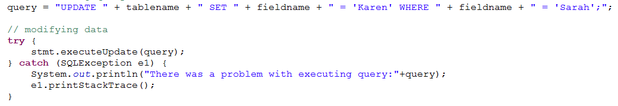
Running Update Queries
Can be run with a default ResultSet (CONCUR_READ_ONLY)
Can be INSERT, UPDATE, or DELETE

Slide 17
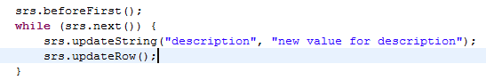
Update a Table via Result Set

Slide 18

Prepared Statements
Create a prepared statement with placeholders for the values

Slide 19
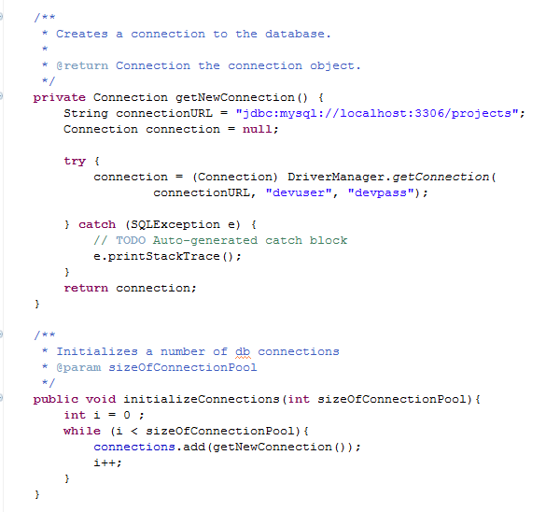
Managing database connections

Slide 20
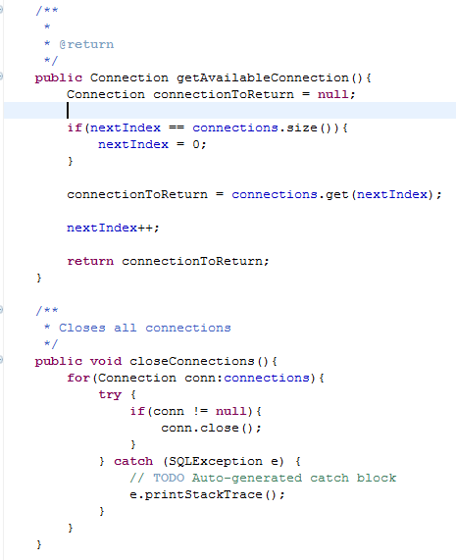
Managing database connections

Slide 21
Look at the Documentation for java.sql
Connection
Statement
ResultSet

